Slide 1
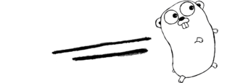
Compiler Construction
Programming Assignment 3 Generate Java Assembly Code for μGo
Notes:
First of all, I would like to thank the department for the chance to introduce myself.

Slide 2
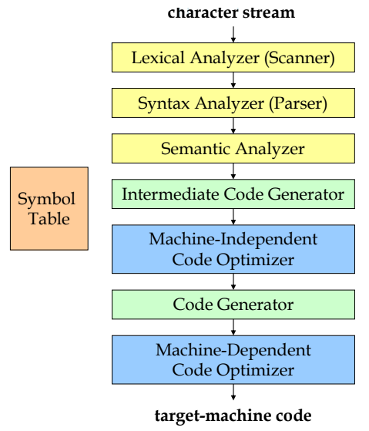
Project Outline
μGo program
HW1
HW2
HW3
Jasmin
Instructions
Notes:
以架構來看的話作業二涵蓋的區塊如圖

Slide 3
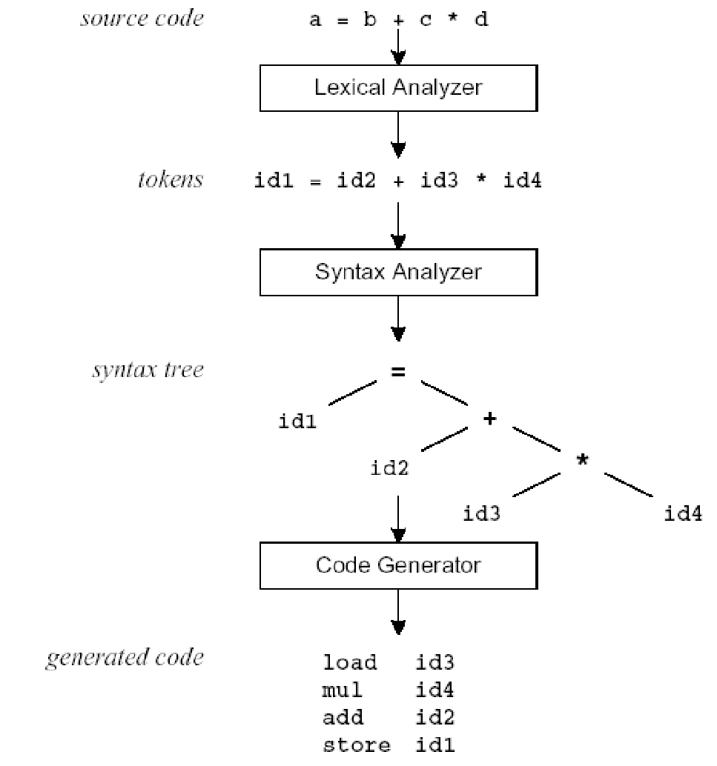

What to do in this Assignment?
To accomplish the last step of building your μGO compiler, which converts the μGO program into the Java assembly code.
Code Generation:
Inject the Jasmin assembly instructions into your flex/bison code developed in the previous assignments.
1
2
3

Slide 4
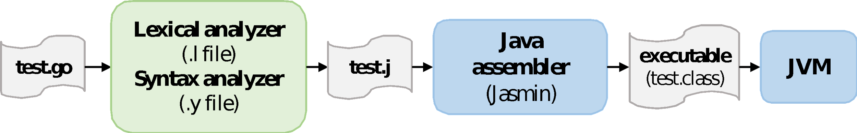
What to do in this Assignment? (cont.)
Your compiler generates the Jasmin assembly code (test.j) for the given input program (test.go).
The generated code will then be translated to the Java bytecode (test.class) by the Java assembler, Jasmin.
The generated Java bytecode should be run by the Java Virtual Machine (JVM).
In this assignment,
TAs give the score based on your .j file and the JVM execution results.
The flex/bison files need to print out the error messages as hw2 did.
3

Slide 5
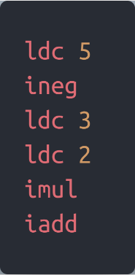
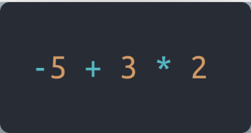
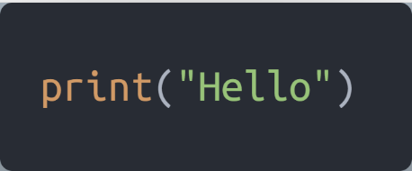
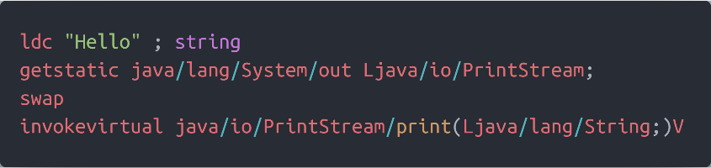
Simple examples
μGo program
Jasmin Instructions
Your compiler
Your compiler

Slide 6
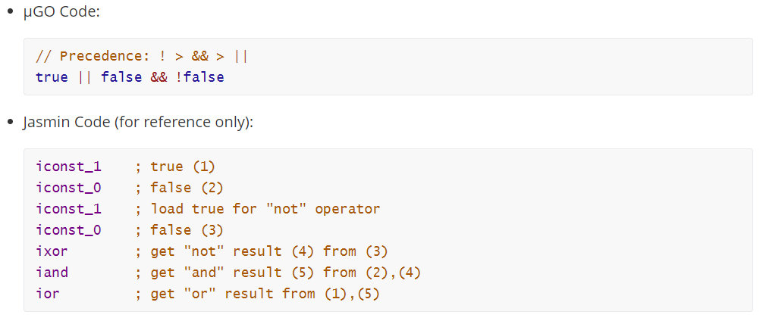
Simple examples (cont.)
We also give several examples in the appended document
However, the corresponding Jasmin codes are just for reference, so you can write your own version while it can produce the same program outputs.

Slide 7
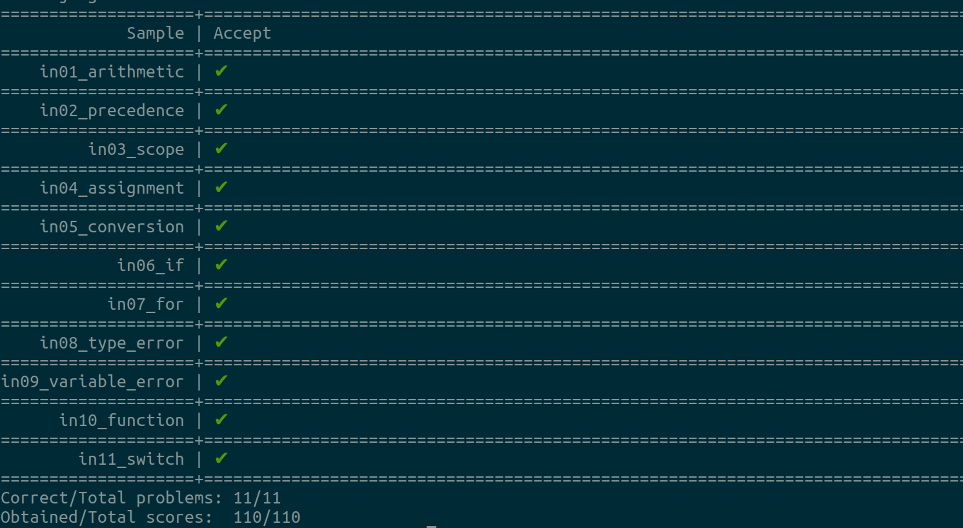
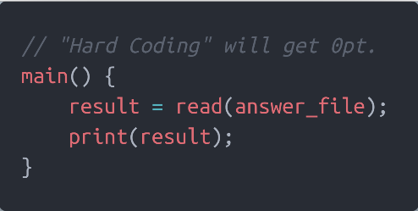
Assignment Requirements
Each test case is 10pt and the total score is 110pt.
https://github.com/aben20807/local-judge/tree/master/examples/student

Slide 8
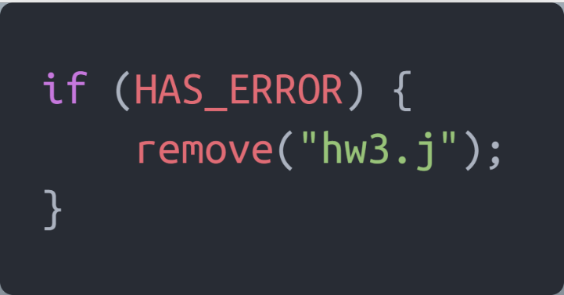
Assignment Requirements (cont.)
When ERRORs occur during the parsing phase,
Print out ALL error messages, as Assignment 2 did, and
DO NOT generate the Java assembly code (.j file).

Slide 9
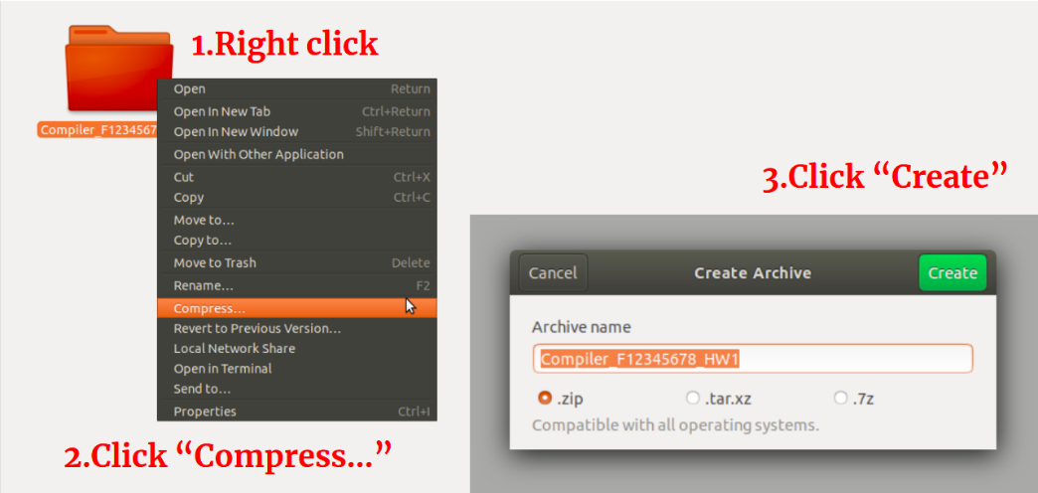
Submission
Upload your homework to Moodle.
The expected arrangement of your codes:
Only .zip and .rar types of compression are allowed.
The directory should be organized as:
You will lose 10pt if your programs were uploaded in incorrect format!!!
Compiler_StudentID_HW3.zip/
└── Compiler_StudentID_HW3/
├── compiler_hw3.l
├── compiler_hw3.y
├── common.h
├── jasmin.jar
└── Makefile
3

Slide 10
Deadline
Postpone
30% off
5/13
Hw3 release
6/9
23:59 Deadline
6/10
DEMO

Slide 11
About DEMO
Demo time is 12:00-18:30, 6/10
The demo is partitioned into several time periods.
We will open a Google Form for you to register your demo time slot.
Each time period allows less than 26 people to demo.
Demo will be held in virtual
You are responsible for your code.
If you cannot explain your code clearly, you score will be discounted.
Please come to demo ON TIME.

Slide 12
How to Mail TAs
Send mail to asrlab@csie.ncku.edu.tw, not any TA’s mail!!
Email subject starts with “[Compiler2022]”

Slide 13
QUESTIONS ?

